Slide 1
Unit – II
Uninformed Search Strategies: Breadth-first search
Uniform cost search
Depth- first search
Iterative deepening Depth-first search
Bidirectional search.
Informed (Heuristic) Search Strategies: Heuristic Functions
Hill- climbing
Greedy best-first search
A* search
Adversarial Search: Game Theory
Alpha–Beta Pruning
Constraint Satisfaction Problems.

Slide 2
Uninformed Search Strategies
Definition: Uninformed search strategies, also known as blind search strategies, operate without any domain-specific knowledge beyond the problem definition. They explore the search space uniformly and use only the information available in the problem's structure.
Examples:
Breadth-First Search (BFS): Explores all nodes at the present depth level before moving on to nodes at the next depth level.
Depth-First Search (DFS): Explores as far down a branch as possible before backtracking.
Uniform Cost Search (UCS): Expands the least-cost node first.
Informed (Heuristic) Search Strategies
Definition: Informed search strategies, also known as heuristic search strategies, utilize additional domain-specific information to make more informed decisions about which nodes to expand. They use heuristics to estimate the cost to reach the goal, aiming to improve search efficiency.
Examples:
Greedy Best-First Search: Expands the node with the lowest heuristic cost.
A Search:* Expands the node with the lowest combined cost of the path so far and the estimated cost to the goal.

Slide 3
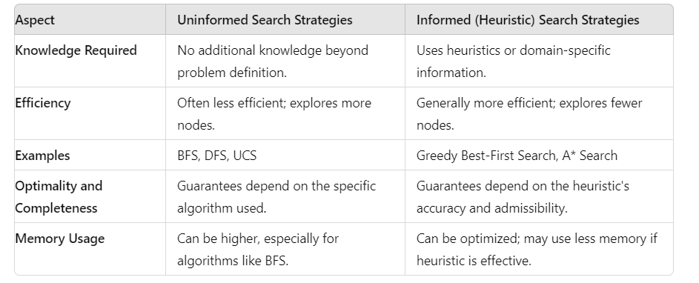
Differences between Uninformed and Informed Search Strategies

Slide 4
Breadth-first search
Definition: Breadth-First Search (BFS) expands the root node first.
Then, it expands all the successors of the root node. Continues expanding successors level by level.
Mechanism:
BFS uses a FIFO (First In, First Out) queue to manage the frontier.
The shallowest unexpanded node is chosen for expansion.
The goal test is applied when a node is generated, not when selected for expansion.
Optimality and Completeness:
Complete: BFS will find the goal if it exists at some finite depth ddd.
Optimal: BFS is optimal if path cost is a non-decreasing function of node depth. Typically, it is optimal if all actions have the same cost.
Time and Space Complexity:
Time Complexity:O(b^d) ,where b is the branching factor and d is the depth of the solution.
Space Complexity:O(b^d) dominated by the size of the frontier.
Both time and space complexities are exponential in the depth of the solution, making BFS impractical for large depths.
Performance Analysis:
In a uniform tree with branching factor b, the number of nodes at depth d is b^d.
The total number of nodes generated up to depth d is b + b^2 + ....... + b^d = O(b^d)
If goal test is applied upon node expansion, time complexity would be O(b^{d+1})

Slide 5
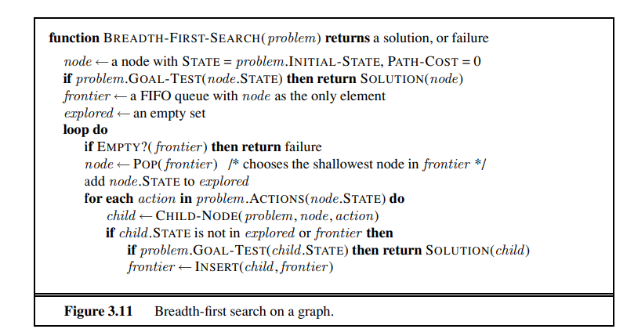
Example problem discussed in class—please refer to the class notes for details.

Slide 6
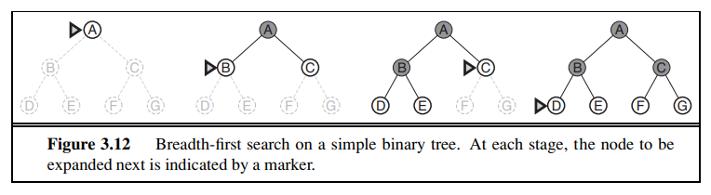
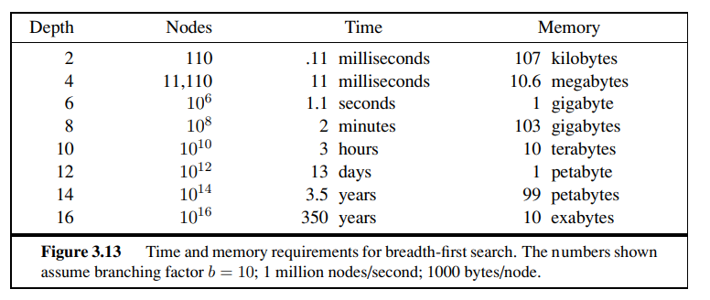

Slide 7
Memory is a Major Limitation:
More so than execution time, memory constraints often render BFS impractical for deep search problems.
Exponential Growth:
Both time and space complexities demonstrate that exponential search problems are infeasible for uninformed
methods beyond small instances.
Breadth-First Search is effective for finding the shortest path in terms of the number of edges but is severely limited by its
high time and space complexities for large search depths. Alternative search strategies that require less memory are often
preferred for practical applications.
Practical Considerations:
Memory Requirements: Memory usage grows exponentially with depth. For a branching factor of 10, memory requirements can become prohibitive (e.g., 10^8 nodes need 103 GB at depth 8).
Execution Time: Time also grows exponentially. Finding a solution at depth 16 can take centuries with current hardware capabilities.

Slide 8
Uniform-cost search
Definition: Uniform-Cost Search (UCS) is an algorithm that expands the node with the lowest path cost.
Priority Queue: UCS uses a priority queue ordered by path cost g(n)g(n)g(n) to manage the frontier.
Differences from Breadth-First Search
Goal Test Application: UCS applies the goal test when a node is selected for expansion.
Path Cost Consideration: UCS expands nodes based on path cost rather than depth.
Priority Queue Management: Handles frontier nodes more efficiently by using a combination of a priority queue and a hash table.

Slide 9
Pseudocode of Uniform-Cost Search
function UNIFORM-COST-SEARCH(problem) returns a solution, or failure
node ← a node with STATE = problem.INITIAL-STATE, PATH-COST = 0
frontier ← a priority queue ordered by PATH-COST, with node as the only element
explored ← an empty set
loop do
if EMPTY?(frontier ) then return failure
node ← POP(frontier ) /* chooses the lowest-cost node in frontier */
if problem.GOAL-TEST(node.STATE) then return SOLUTION(node)
add node.STATE to explored
for each action in problem.ACTIONS(node.STATE) do
child ← CHILD-NODE(problem, node, action)
if child.STATE is not in explored or frontier then
frontier ← INSERT(child, frontier )
else if child.STATE is in frontier with higher PATH-COST then
replace that frontier node with child

Slide 10
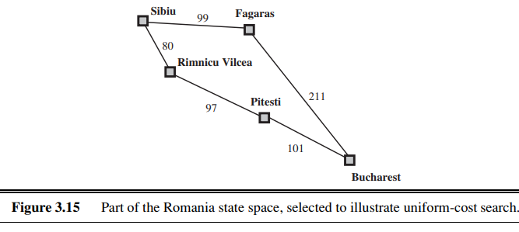
Example - Romania Map Problem
Objective: Travel from Sibiu to Bucharest.
Nodes and Costs: Rimnicu Vilcea (80), Fagaras (99), Pitesti (177), Bucharest (278, 310).
Process: Nodes are expanded in order of their path costs, ensuring the optimal path is found.
Optimality of Uniform-Cost Search
Path Cost Selection: UCS ensures that the node selected for expansion has the lowest path cost.
Non-Negative Step Costs: Guarantees optimal path cost by expanding nodes in order of increasing path cost.
Handling Infinite Loops
Zero-Cost Actions: UCS can get stuck in infinite loops with sequences of zero-cost actions (e.g., NoOp actions).
Solution: Ensures completeness by assuming every action costs at least a small positive constant ϵ.

Slide 11

Complexity Analysis
Variables:
  C∗: Cost of the optimal solution.
  ϵ: Minimum step cost.
Worst-Case Time and Space Complexity
Comparison with BFS: UCS can be more complex due to exploring large trees of small steps.
Breadth-First Search vs. Uniform-Cost Search
Equal Step Costs: UCS is similar to BFS when all step costs are equal.
Goal Node Examination: UCS checks all nodes at the goal's depth for the lowest cost, while BFS stops at the first goal.
Practical Considerations
Memory Requirements: UCS requires significant memory for storing nodes in the priority queue and explored set.
Execution Time: UCS can be time-consuming for problems with large optimal solution costs.
Conclusion
Use Case: UCS is suitable for problems where step costs vary and an optimal solution is required.
Limitations: Memory and time complexity can be significant, especially for large problems with many small steps.
Example problem discussed in class—please refer to the class notes for details.

Slide 12
Depth-first search
Definition: DFS expands the deepest node in the current frontier of the search tree.
Search Strategy: Proceeds to the deepest level, backs up when no successors are found.
DFS Implementation
Algorithm Type: Graph-search and tree-search variations.
Queue Type: LIFO (Last-In, First-Out) queue, ensuring the deepest unexpanded node is chosen.
Alternative Implementation: Recursive function calls.
DFS Properties and Example
Graph-Search vs. Tree-Search: Graph-search avoids repeated states, while tree-search does not.
Completeness: Graph-search is complete in finite state spaces; tree-search is not.
Example: Tree expansion with nodes A to J, showing DFS progression.
Completeness and Optimality
Completeness:
  Graph-Search: Complete in finite state spaces.
  Tree-Search: Not complete, can get stuck in infinite loops.
Optimality: DFS is not optimal; it may not find the shortest or least-cost path to a goal.

Slide 13
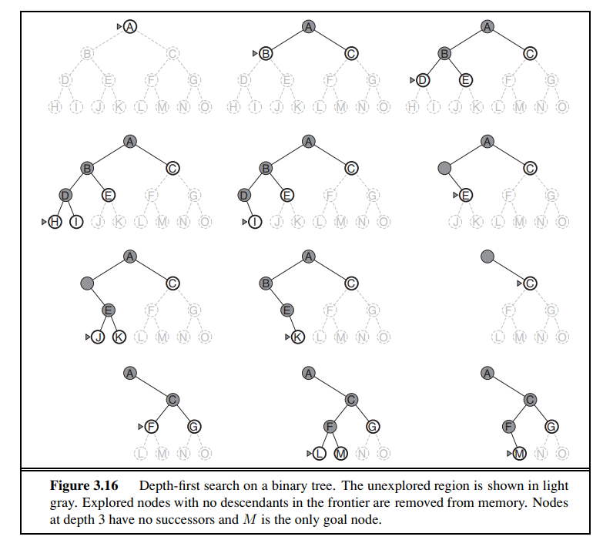

Slide 14
function DEPTH-FIRST-SEARCH(problem) returns a solution, or failure
node ← a node with STATE = problem.INITIAL-STATE
frontier ← a LIFO queue with node as the only element
explored ← an empty set
loop do
if EMPTY?(frontier) then return failure
node ← POP(frontier)
if problem.GOAL-TEST(node.STATE) then return SOLUTION(node)
add node.STATE to explored
for each action in problem.ACTIONS(node.STATE) do
child ← CHILD-NODE(problem, node, action)
if child.STATE is not in explored or frontier then
frontier ← INSERT(child, frontier)
Example problem discussed in class—please refer to the class notes for details.

Slide 15
Time Complexity of DFS
Graph Search: Bounded by the size of the state space.
Tree Search: Can generate O(b^m) nodes, where m is the maximum depth.
Depth (m) vs. Solution Depth (d): m can be much larger than d and infinite in unbounded trees.
Space Complexity of DFS
Graph Search: No advantage in space complexity.
Tree Search: Requires storage of O(bm) nodes.
Memory Efficiency: DFS uses significantly less memory than BFS, especially at large depths.
Practical Applications of DFS
Areas of Use: Constraint satisfaction, propositional satisfiability, logic programming.
Memory Efficiency: Critical for success in areas with large state descriptions.
Backtracking Search
Definition: A variant of DFS that generates one successor at a time.
Memory Use: Needs only O(m) memory, further reduced to one state description and O(m) actions.
Technique: Modifies current state description directly, must be able to undo modifications.
Advantages: Space efficiency, foundational in many AI applications.
Limitations: Not complete in infinite state spaces, nonoptimal paths.
Memory-Saving Techniques: Backtracking search and state modification critical for large problems.

Slide 16
Iterative deepening depth-first search
Definition: IDS is a search strategy that combines the benefits of Depth-First Search (DFS) and Breadth-First Search (BFS).
It gradually increases the depth limit from 0 upwards until the goal is found.
Why Use Iterative Deepening Search?
  Memory Efficiency: Like DFS, IDS has modest memory requirements, O(bd).
  Completeness: Like BFS, IDS is complete when the branching factor is finite.
  Optimality: IDS is optimal when the path cost is a nondecreasing function of node depth.
How IDS Works
  IDS repeatedly applies Depth-Limited Search (DLS) with increasing depth limits.
function ITERATIVE-DEEPENING-SEARCH(problem) returns a solution, or failure
for depth = 0 to ∞ do
result ← DEPTH-LIMITED-SEARCH(problem, depth)
if result ≠ cutoff then return result

Slide 17
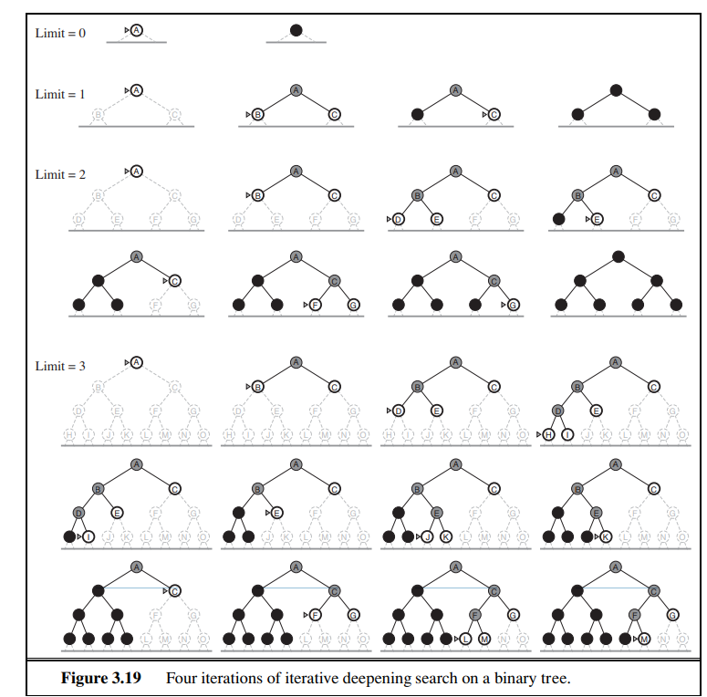
Depth-Limited Search (DLS)
  DLS is a DFS with a predetermined depth limit.
  It explores nodes up to the specified depth limit and returns failure if the goal is not found within this limit.
Iterative Process
  IDS starts with depth = 0 and increases it incrementally.
  Each iteration runs DLS to the current depth limit.
  Example illustration of IDS on a binary tree:
    Limit = 0: Explores root only.
    Limit = 1: Explores root and its children.
    Limit = 2: Explores root, children, and grandchildren, and so on.
Use show the iterations on a binary tree.
Highlight how nodes at each level are explored fully before increasing the limit.

Slide 18
Time Complexity Analysis
  Worst-case time complexity: O(bd), where b is the branching factor and d is the depth of the shallowest goal node.
Formula for total nodes generated
N(IDS) = (d)b + (d-1)b^2 + ... + (1)bd
Example calculation for b = 10, d = 5
N(IDS) = 50 + 400 + 3,000 + 20,000 + 100,000 = 123,450
N(BFS) = 10 + 100 + 1,000 + 10,000 + 100,000 = 111,110
Practical Considerations
IDS may seem wasteful due to repeated state generation.
Upper-level nodes are generated multiple times, but this overhead is minor compared to the overall search cost.
Comparison of node generations at different levels.
Example problem discussed in class—please refer to the class notes for details.

Slide 19
Conclusion
IDS is a powerful search strategy combining the benefits of DFS and BFS.
Ideal for large search spaces with unknown solution depths.
Balances memory efficiency and completeness/optimality.
Iterative Lengthening Search
Analogous to IDS but uses increasing path-cost limits instead of depth limits.
This approach is optimal but incurs more overhead than uniform-cost search.
Hybrid Approaches
Combining BFS and IDS: Run BFS until memory is almost full, then use IDS from frontier nodes.
Benefits: Balances memory use and search efficiency.

Slide 20
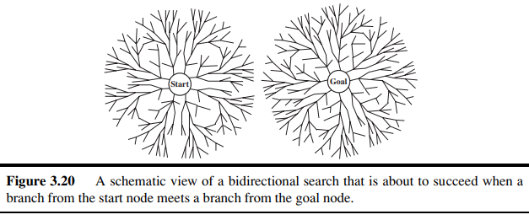
Bidirectional search
bidirectional search is to run two simultaneous searches—one forward from the initial state and the other backward from the goal—hoping that the two searches meet in the middle(This algorithm stops when both search meet in the middle)
Can (sometimes) lead to finding a solution more quickly.
The motivation is that bd/2 + bd/2 is much less than bd, or in the figure, the area of the two small circles is less than the area of one big circle centered on the start and reaching to the goal.
Can be implemented using BFS or iterative deepending (but at least one frontier needs to be kept in memory)
Works well only when there are unique start and goal states.
Complete: yes(if only single goal, otherwise difficult)
Time complexity: O(b^d/2)(Better when compared to other algorithms)
Space complexity: O(b^d/2) (Space requriment is more.
Optimal: Yes, But not always optimal, even if both searches are BFS
Check when each node is expanded or selected for expansion.
Example problem discussed in class—please refer to the class notes for details.

Slide 21
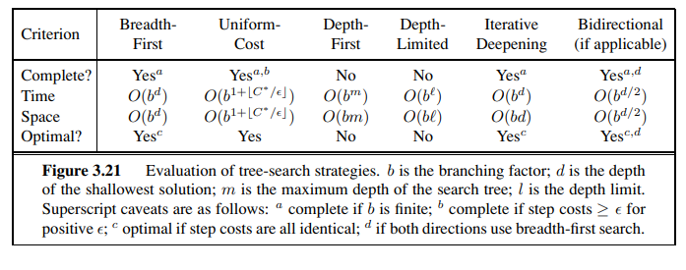
Comparing uninformed search strategies

Slide 22
INFORMED (HEURISTIC) SEARCH STRATEGIES
Informed Search Strategy: Informed search strategies use problem-specific knowledge beyond just the problem definition to find solutions more efficiently than uninformed search strategies. These strategies incorporate additional information to make more informed decisions about which paths to explore in the search space.
Best-First Search: Best-first search is a type of informed search strategy. It is a general approach that selects which node to expand based on an evaluation function, denoted as f(n). This evaluation function estimates the cost associated with expanding a node, and the node with the lowest estimated cost is expanded first.
Evaluation Function (f(n)): The evaluation function is a key component of best-first search. It is used to order nodes in the priority queue, determining the order in which nodes are expanded. The choice of the evaluation function f directly affects the search strategy.
Uniform-Cost Search Similarity: The implementation of best-first search is similar to uniform-cost search but differs in the function used to order the priority queue. While uniform-cost search uses the cost to reach a node g(n), best-first search uses f(n)f(n)f(n), which can include other heuristic information.
Heuristic Function (h(n)): A common component of the evaluation function in best-first search is the heuristic function h(n). The heuristic function estimates the cost of the cheapest path from a node n to a goal state. It is a nonnegative, problem-specific function that provides additional knowledge to guide the search process.
Use of Heuristic Information: Heuristic functions help in guiding the search towards the goal more effectively by providing an estimate of the cost remaining to reach the goal. This estimate helps prioritize nodes that appear to be closer to a solution.
Goal Node Condition: For heuristic functions, one key constraint is that if a node n is a goal node, then h(n)=0. This ensures that the heuristic function is admissible and never overestimates the cost to reach the goal.
Efficiency: By using heuristic information, best-first search strategies can significantly reduce the number of nodes expanded during the search, leading to more efficient solutions compared to uninformed strategies.

Slide 23
Greedy best-first search
Greedy Best-First Search is a search algorithm that expands the node that appears to be closest to the goal, based on the heuristic function h(n). It aims to find a solution quickly by always choosing the path that seems to be the shortest to the goal.
It is the combination of depth first search and breadth first search algorithms
It uses, the heuristic function and search
With the help of best first search at each step, we can choose the most promising node.
In the best first search algorithm, we expand the node, which is closest to the goal node and the minimum cost is estimated by heuristic function.
Evaluation Function: In Greedy Best-First Search, the evaluation function is simply the heuristic function: f(n)=h(n). This function estimates the cost from the current node n to the goal.
Greedy Sir ignores the cost of the path that has already been traversed to reach n
Therefore, the solution given is not necessarily optimal
Example - Route-Finding in Romania: For a route-finding problem in Romania, the heuristic function hSLD(n) represents the straight-line distance from a node n to the goal (Bucharest). For instance, hSLD(Arad)=366h
Heuristic Information: The heuristic function hSLD is based on prior knowledge (like straight-line distances) that cannot be directly computed from the problem's description. The heuristic's usefulness depends on its correlation with the actual costs (e.g., road distances).

Slide 24
Search Example: In the example of finding a path from Arad to Bucharest using Greedy Best-First Search with hSLDh​, the algorithm expands Sibiu first (closest to Bucharest), then Fagaras, and finally Bucharest. This solution path doesn't expand any unnecessary nodes, showing minimal search cost.
Non-Optimality: Although the search finds a path quickly, it is not necessarily the shortest path. For instance, the path through Sibiu and Fagaras to Bucharest is 32 kilometers longer than the shortest path through Rimnicu Vilcea and Pitesti.
Greedy Nature: The algorithm is called "greedy" because at each step, it chooses the node that seems closest to the goal according to the heuristic, without considering the overall optimal path.
Incompleteness: Greedy Best-First Tree Search is not guaranteed to find a solution, even in a finite state space, similar to Depth-First Search. For example, when searching from Iasi to Fagaras, it might expand Neamt first (closest to Fagaras by heuristic), leading to a dead end and an infinite loop if backtracking is not allowed.
Graph Search Version: The graph search version of Greedy Best-First Search is complete in finite spaces because it avoids revisiting nodes. However, it is not complete in infinite state spaces due to the risk of infinite loops.
Complexity: In the worst case, the time and space complexity of the tree version is O(b^m) where b is the branching factor and m is the maximum depth of the search space.
Heuristic Impact: With a good heuristic function, the complexity of the search can be significantly reduced, making the algorithm more efficient. The extent of this reduction depends on the specific problem and the quality of the heuristic used.
Example problem discussed in class—please refer to the class notes for details.

Slide 25
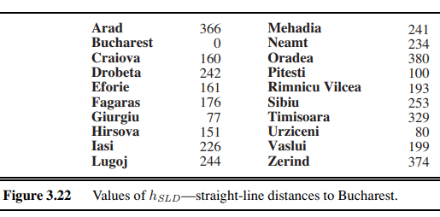
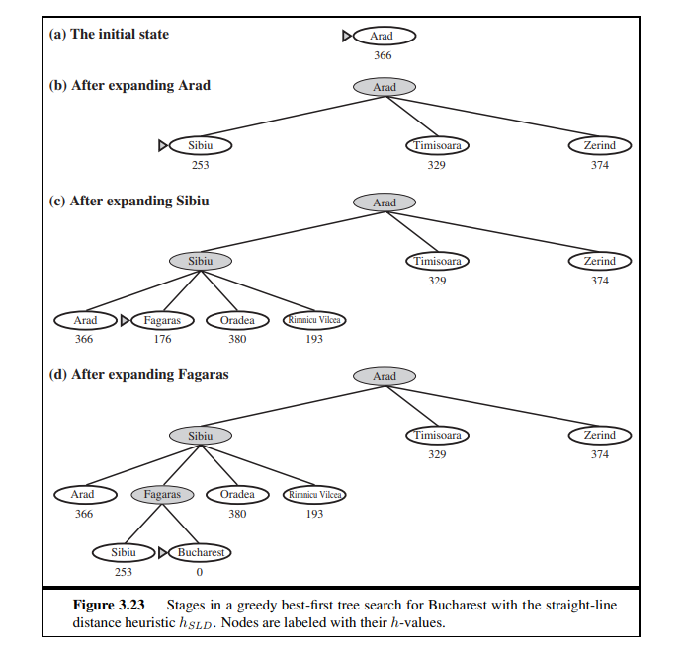

Slide 26
A* search: Minimizing the total estimated solution cost
A* search is a popular best-first search algorithm that evaluates nodes by combining two functions:
g(n): the cost to reach the node n from the start node.
h(n) : the estimated cost to reach the goal from node n.
The evaluation function is defined as f(n)=g(n)+h(n)f, which represents the estimated total cost of the cheapest solution through node n.
Goal of A Search*:
A* aims to find the least-cost path from the start node to the goal node by always expanding the node with the lowest f(n) value.
Completeness and Optimality:A* search is complete (will always find a solution if one exists) and optimal (will find the least-cost solution) if the heuristic function h(n)
satisfies certain conditions, specifically admissibility and consistency.

Slide 27
Admissible Heuristic: A heuristic function h(n) is called admissible if it never overestimates the cost to reach the goal from node n. This means that for all nodes, h(n) is less than or equal to the actual cost to reach the goal.
Admissible heuristics are "optimistic" because they assume the cost to reach the goal is less than or equal to the actual cost.
Example of Admissible Heuristic:The straight-line distance heuristic (hSLD) is admissible because the shortest path between any two points is a straight line, which cannot overestimate the true cost.
Consistency (Monotonicity):A heuristic h(n) is consistent (or monotonic) if, for every node n and successor n′ of n, the estimated cost to reach the goal from n is no greater than the cost of getting to n′ plus the estimated cost from n′ to the goal: h(n)≤c(n,a,n′)+h(n′).
This property ensures that the estimated cost h(n) follows the triangle inequality, meaning the direct path from n to the goal should not be more expensive than going through an intermediate node n′.
Relation Between Consistency and Admissibility:Every consistent heuristic is also admissible, but not every admissible heuristic is necessarily consistent. Consistency is a stricter requirement.
Example problem discussed in class—please refer to the class notes for details.

Slide 28
Practical Example
In a route-finding example to Bucharest, A* search might initially find a suboptimal path (e.g., through Pitesti) if the heuristic value h(n) for a different node (like Bucharest) results in a higher f(n). This ensures that all possible paths are considered to find the cheapest one.
Triangle Inequality:The triangle inequality principle in the context of heuristics means that the cost from node n to the goal via an intermediate node n′ should not be cheaper than the direct path from n to the goal, ensuring the heuristic remains a lower bound.
For graph search (as opposed to tree search), consistency is crucial for A* to ensure that once a node is expanded, it does not need to be revisited, which guarantees optimality in finding the least-cost path.

Slide 29
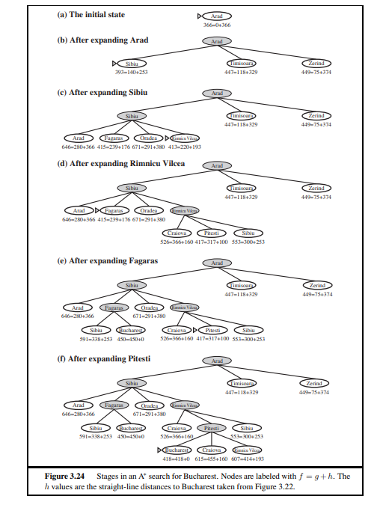

Slide 30
HEURISTIC FUNCTIONS
The 8-puzzle problem is a classic example used in heuristic search studies. In the problem, the goal is to rearrange a set of numbered tiles on a 3x3 grid by sliding them into an empty space until the tiles match a specific goal configuration. This task can be solved by various search algorithms, and the effectiveness of these algorithms can be enhanced by using heuristics.
Heuristic Functions:
h1: Number of Misplaced Tiles
  This heuristic counts how many tiles are not in their goal position. For example, if all eight tiles are out of place, then h1=8. This is an admissible heuristic because each misplaced tile must be moved at least once to reach its goal position.
h2: Manhattan Distance (City Block Distance)
This heuristic calculates the sum of the distances each tile is away from its goal position, only counting horizontal and vertical moves. It is also admissible because moving a tile closer to its goal position reduces the distance by one step.
Effectiveness of Heuristics:
The effectiveness of a heuristic can be measured by the effective branching factor, which is an estimate of the average number of child nodes expanded per node. A lower effective branching factor indicates a more efficient search.
The results from experiments show that heuristic h2 (Manhattan distance) is generally more effective than h1 (number of misplaced tiles) because it gives a more accurate estimate of the steps required to solve the puzzle.
Pattern Databases:
Pattern databases store the exact solution costs for every possible subproblem configuration. For instance, a database might store the cost to solve a subset of the puzzle, such as arranging the tiles 1, 2, 3, and 4. These databases provide admissible heuristics that can be looked up during the search to give accurate estimates of the cost to reach the goal.
Disjoint Pattern Databases: These store information for non-overlapping subsets of the puzzle, which can further reduce the number of nodes generated during the search.
Learning Heuristics from Experience:
Another method to generate heuristics is by learning from experience, such as solving multiple instances of the 8-puzzle and using the data to predict the cost of reaching the goal from different states. Machine learning techniques like neural networks and decision trees can be employed to learn these heuristics.
Example problem discussed in class—please refer to the class notes for details.

Slide 31
Local Search Algorithms
Local search algorithms focus on exploring the state space without systematically keeping track of the path to reach the goal.
They operate using a single current node and move only to neighbors of that node, not retaining the paths followed by the search.
Characteristics:
Path Irrelevance: In many problems, the path to the goal is irrelevant; only the final state matters (e.g., 8-queens problem, integrated-circuit design, factory-floor layout).
Memory Efficiency: They use very little memory, usually a constant amount, making them suitable for large or infinite state spaces.
Optimization Focus: Often used for solving optimization problems, where the goal is to find the best state according to an objective function rather than a specific goal state or path.
Optimization Problems:
Objective Function: Local search algorithms are designed to optimize an objective function, which is a measure of how good a particular state is (e.g., reproductive fitness in evolution, where there's no explicit goal test or path cost).

Slide 32
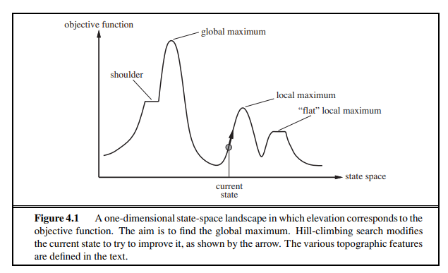
State-Space Landscape:
Location and Elevation: The state-space landscape has "location" (defined by the state) and "elevation" (defined by the heuristic cost function or objective function).
Global Minimum/Maximum: Depending on the problem, the algorithm aims to find the lowest valley (global minimum) or the highest peak (global maximum).
Advantages:
Low Memory Usage: Local search algorithms use minimal memory, making them efficient for problems with large state spaces.
Suitable for Large or Infinite State Spaces: They can find reasonable solutions even when systematic algorithms are not feasible due to the size or continuity of the state space.
Completeness and Optimality:
A complete local search algorithm will find a goal if one exists.
An optimal local search algorithm will find the global minimum or maximum.

Slide 33
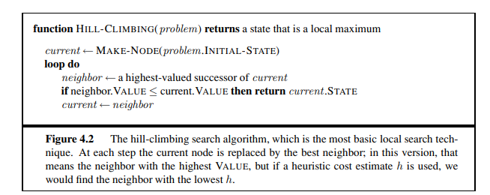
Hill-Climbing Search Algorithm
A local search algorithm that continually moves in the direction of increasing value, aiming to reach a peak or maximum value point.
The algorithm stops when it reaches a state where no neighboring state has a higher value.
Steepest-Ascent Hill Climbing:
Chooses the neighbor with the highest value (steepest ascent).
Does not maintain a search tree; focuses on the current state and its immediate neighbors.
Example: 8-queens problem, where the objective is to minimize the number of attacking pairs of queens. Moves are made to lower the heuristic cost function h.
Characteristics:
Greedy Local Search: Chooses the best immediate option without considering long-term consequences. It can be efficient but may get stuck.
Stuck Scenarios:
  Local Maxima: Peaks that are higher than neighboring states but not the global maximum.
  Ridges: Sequences of local maxima that are difficult to navigate.
  Plateaux: Flat areas that can either be flat local maxima or shoulders where progress is still possible.

Slide 34
Variations:
Stochastic Hill Climbing: Randomly selects from among the uphill moves, potentially slower but can find better solutions in some landscapes.
First-Choice Hill Climbing: Randomly generates successors until a better one is found; useful when there are many successors.
Random-Restart Hill Climbing: Repeatedly performs hill climbing from randomly generated initial states until a goal is found. It increases completeness by ensuring that a solution will eventually be found with enough attempts.
Advantages:
Efficiency: Rapidly improves a bad state in many cases.
Effectiveness with Random Restarts: Effective for large problems (like 8-queens with millions of states) when combined with random restarts.
Limitations:
Incomplete: Can fail to find a goal if it gets stuck on local maxima or plateaux.
Highly Dependent on State Space Landscape: More effective if there are fewer local maxima and plateaux. Less effective in complex landscapes with many local maxima, typical of NP-hard problems.
Example problem discussed in class—please refer to the class notes for details.

Slide 35
Adversarial Search
Adversarial search is a type of search algorithm used in decision-making processes where two or more players with conflicting interests are involved, such as in games like chess or tic-tac-toe.
The primary goal is to maximize a player's chances of winning while minimizing the opponent's chances. This search approach assumes that the opponent is also playing optimally to maximize their own chances of winning.
S0: The initial state, which specifies how the game is set up at the start.
PLAYER(s): Defines which player has the move in a state.
ACTIONS(s): Returns the set of legal moves in a state.
RESULT(s, a): The transition model, which defines the result of a move.
TERMINAL-TEST(s): A terminal test, which is true when the game is over and false TERMINAL STATES otherwise. States where the game has ended are called terminal states.
UTILITY(s, p): A utility function (also called an objective function or payoff function),
defines the final numeric value for a game that ends in terminal state s for a player p.
In chess, the outcome is a win, loss, or draw, with values +1, 0, or 1 2 . Some games have a wider variety of possible outcomes; the payoffs in backgammon range from 0 to +192. A zero-sum game is (confusingly) defined as one where the total payoff to all players is the same for every instance of the game. Chess is zero-sum because every game has payoff of either 0+1, 1+0 or 1 2 + 1 2 . “Constant-sum” would have been a better term, but zero-sum is traditional and makes sense if you imagine each player is charged an entry fee of 1 2 .
For example , in tic toe the outcome is a win, loss, or draw, with values -1,0, or 1
The initial state, ACTIONS function, and RESULT function define the game tree for the game
Game Tree: a tree where the nodes are game states and the edges are moves.

Slide 36
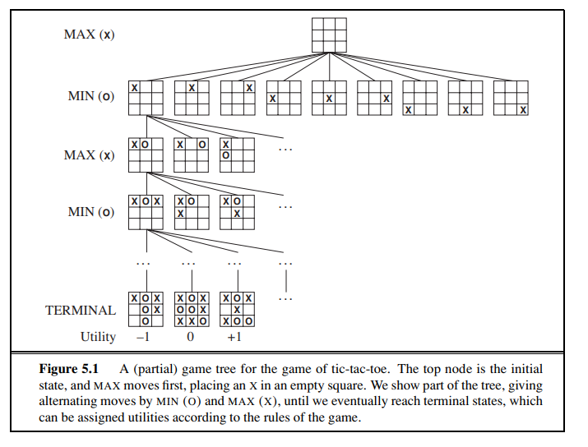
the initial state, MAX has nine possible moves.
Play alternates between MAX’s placing an X and MIN’s placing an O until we reach leaf nodes corresponding to terminal states such that one player has three in a row or all the squares are filled.
The number on each leaf node indicates the utility value of the terminal state from the point of view of MAX
high values are assumed to be good for MAX and bad for MIN
For tic-tac-toe the game tree is relatively small—fewer than 9! = 362, 880 terminal nodes.
But for chess there are over 1040 nodes, so the game tree is best thought of as a theoretical construct that we cannot realize in the physical world.
But regardless of the size SEARCH TREE of the game tree, it is MAX’s job to search for a good move. We use the term search tree for a tree that is superimposed on the full game tree, and examines enough nodes to allow a player to determine what move to make.

Slide 37


Optimal decisions in games
In a normal search problem:
the optimal solution would be a sequence of actions leading to a goal state
In adversarial searchProblem:
-MIN interferes the sequence of actions
-Strategy for Max:
Specify moves in the initial state
observe every possible response by MIN
specify moves in response
and so on..
This optimum strategy can be determined from the Min Max value of each node
This number tells you if a state is Gold or brass
Gold brass

Slide 38
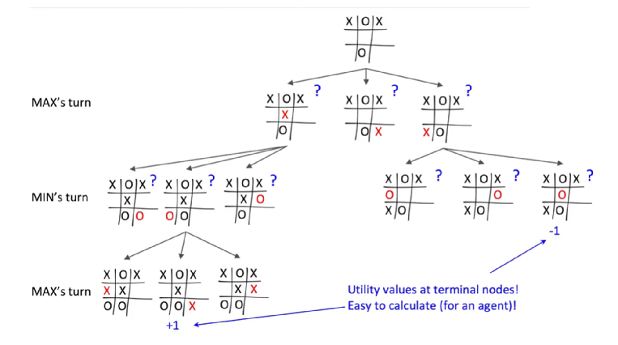
How to calculate utility of non terminal nodes

Slide 39
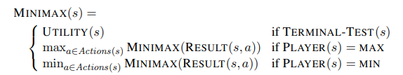
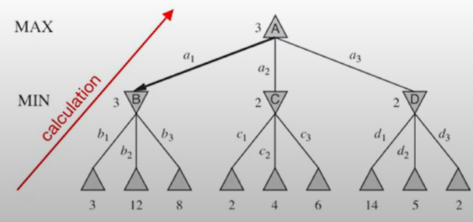
How to calculate minimax value?
Consider a reduced tic tac toe game(Because game tree for full tic tac toe is too big).
-The possible moves for MAX at the root node are labeled a1, a2, and a3
-The possible replies to a1 for MIN are b1, b2, b3, and so on.
the optimal strategy can be determined from the minimax value of each node, MINIMAX(n).
-The minimax value of a node is the utility (for MAX) of being in the corresponding state, assuming that both players play optimally from there to the end of the game.
-Obviously, the minimax value of a terminal state is just its utility. Furthermore, given a choice, MAX prefers to move to a state of maximum value, whereas MIN prefers a state of minimum value.
So we have the following:

Slide 40
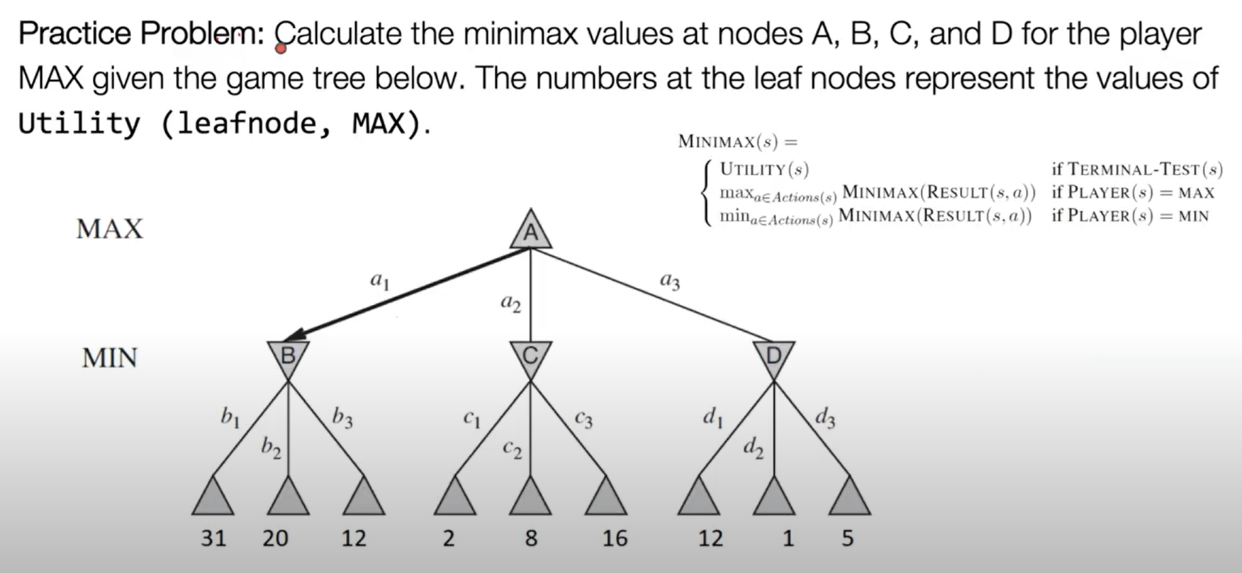

Slide 41
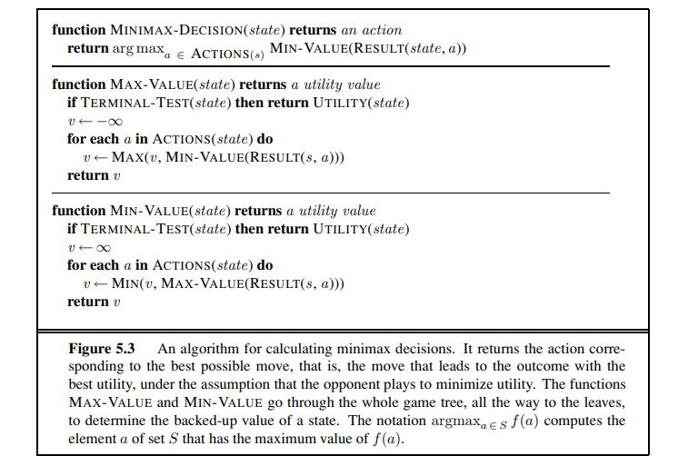
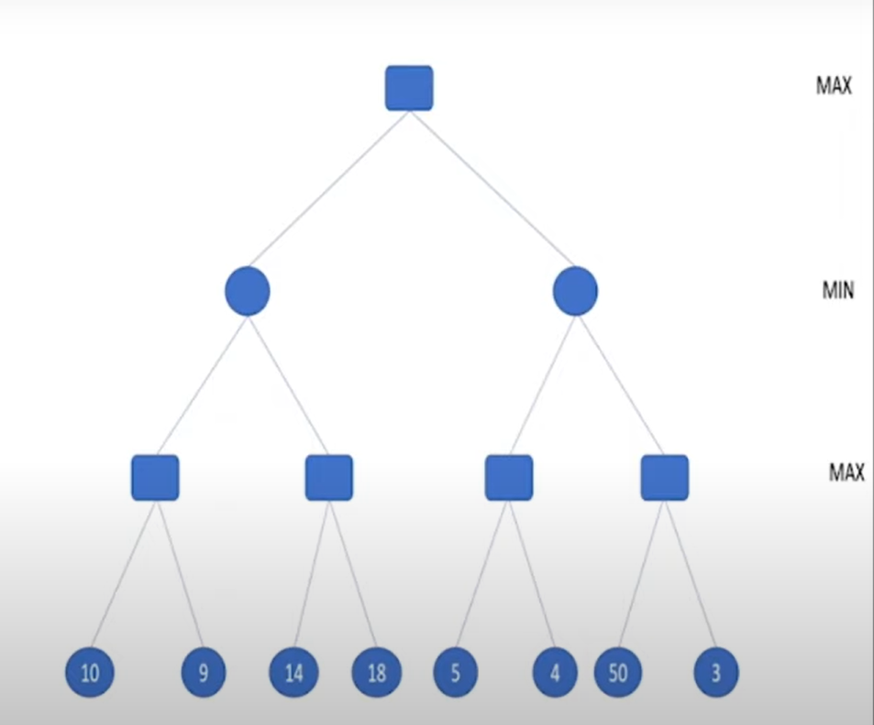
Utility function Vs Minimax function
Utility(s,p): Defines the numeric value for a game that ends in a terminal state s for player p.
Minimax(s,p) : defines the numeric values at all other nodes.(Terminal and non terminal)
The minimax algorithm

Slide 42
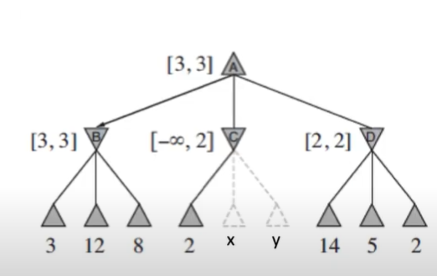
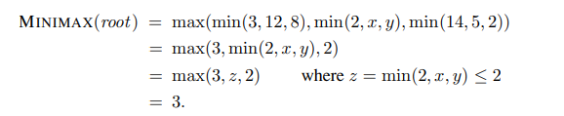
Do we need to compute all ‘MINIMAX’ values?
Let the two unevaluated successors of C have values x and y.
Calculate the MINIMAX(root) or Node A( in terms of x and y):
Is the minimax dependent on the values of x and y?
NO
the value of the root and hence the minimax decision are independent of the values of the pruned leaves x and y.
Which nodes to ignore or Prune?

Slide 43
Properties of Mini-Max algorithm:
Complete- Min-Max algorithm is Complete. It will definitely find a solution (if exist), in the finite search tree.
Optimal- Min-Max algorithm is optimal if both opponents are playing optimally.
Time complexity- As it performs DFS for the game-tree, so the time complexity of Min-Max algorithm is O(b^{m}), where b is branching factor of the game-tree, and m is the maximum depth of the tree.
Space Complexity- Space complexity of Mini-max algorithm is also similar to DFS which is O(bm).
Limitation of the minimax Algorithm:
The main drawback of the minimax algorithm is that it gets really slow for complex games such as Chess, go, etc. This type of games has a huge branching factor, and the player has lots of choices to decide. This limitation of the minimax algorithm can be improved from alpha-beta pruning

Slide 44
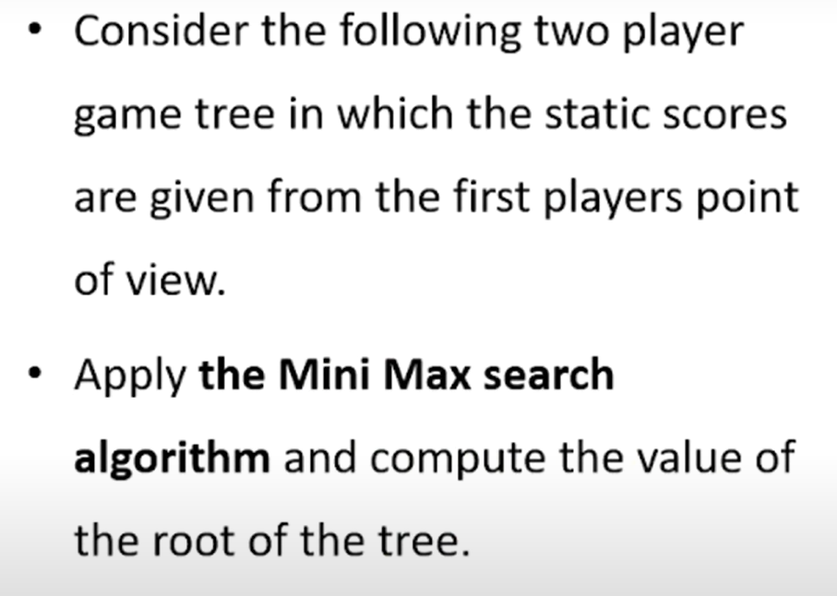
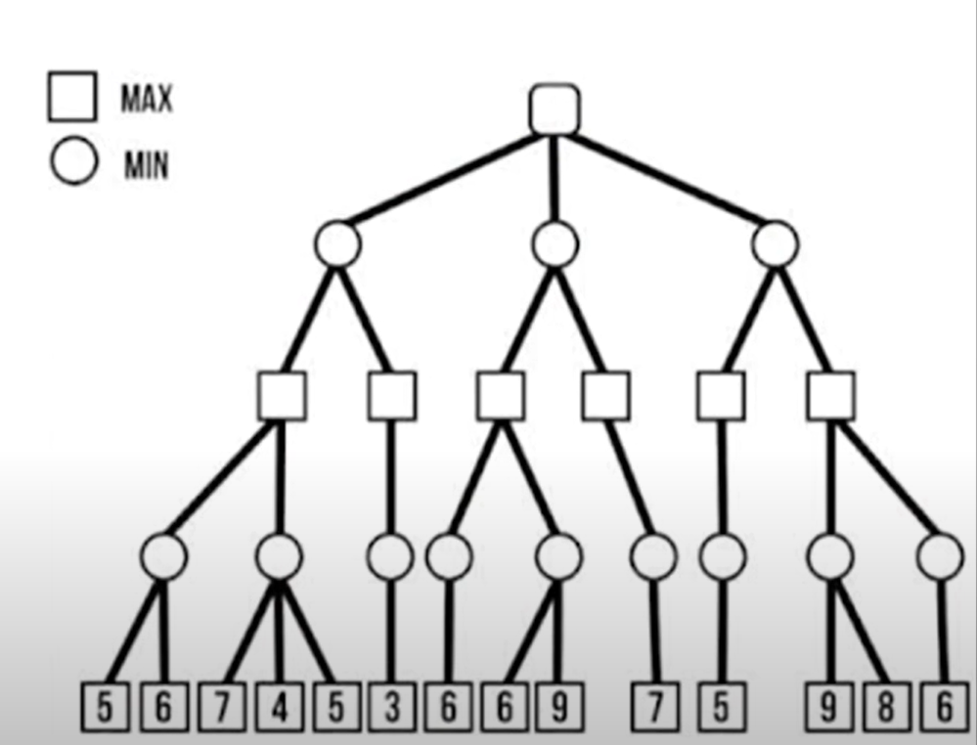
Also find the most convenient path for MAX node

Slide 45
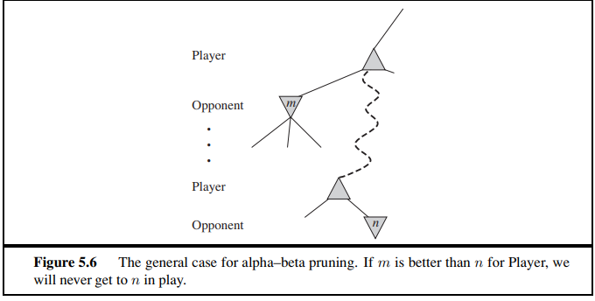
ALPHA–BETA PRUNING
Problem with Minimax Search
Exponential Growth: The number of nodes in the game tree grows exponentially with each additional level.
Example: A game tree with depth d and branching factor b results in b^d leaf nodes to evaluate.
Key Issue: High computational cost for deep trees.
Alpha-Beta Pruning: A search algorithm that reduces the number of nodes evaluated in the minimax algorithm.
Purpose: Prunes branches in the game tree that cannot influence the final decision, effectively cutting the search space.
Principle for PRUNING:
Consider a node ‘n’ somewhere in the tree.,Such that the ‘player’ has a choice of moving to that node.
If the ‘player’ has a better choice ‘M’ either at the parent node ‘N’ or at any choice point, further up, then N will never be reached in actual play
once we have found out enough about n (by examining some of its descendants) to reach this conclusion, we can prune it.

Slide 46
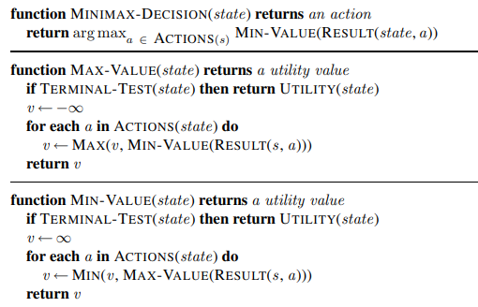
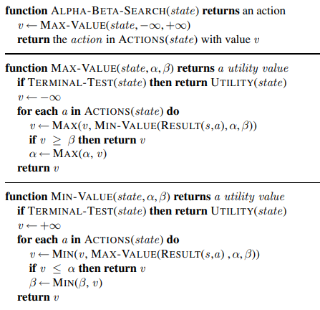
The alpha–beta search algorithm

Slide 47
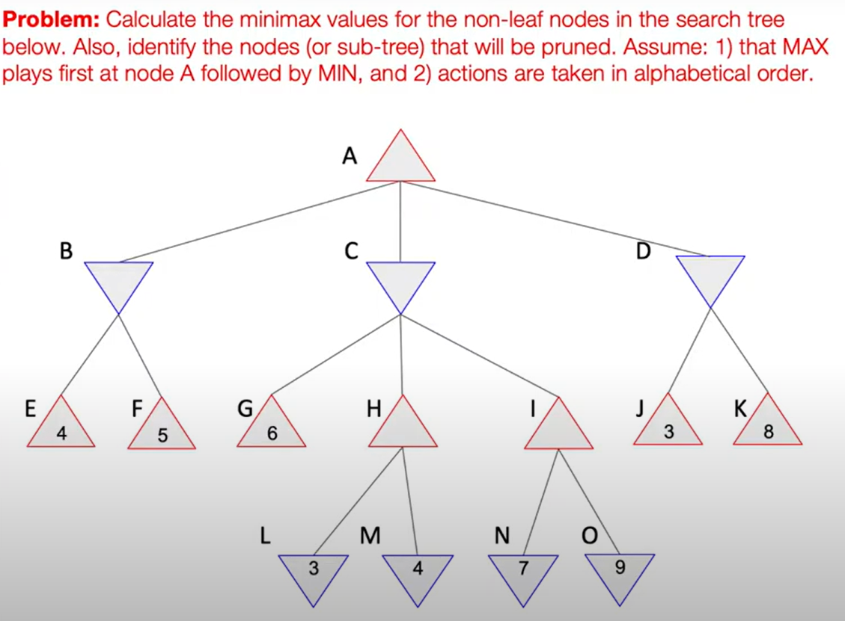
The alpha–beta Pruning algorithm
α = the value of the best (i.e., highest-value) choice we have found so far at any choice point along the path for MAX.
β = the value of the best (i.e., lowest-value) choice we have found so far at any choice point along the path for MIN.
Alpha–beta search updates the values of α and β as it goes along and prunes the remaining branches at a node (i.e., terminates the recursive call) as soon as the value of the current node is known to be worse than the current α or β value for MAX or MIN, respectively

Slide 48
Constraint Satisfaction Problems
Constraint Satisfaction Problems are mathematical questions defined as a set of objects whose state must satisfy a number of constraints or limitations
Csps represent the objects in a problem as a collection of finite constraints over variables which is solved by constraint satisfaction method.
Assignment and solution of CSP
An assignment is complete when every variable is assigned a value
The solution to ACSP is a complete assignment that satisfies all constraints.
Applications :
map colouring
line drawing interpretation
scheduling problems
floor planning for VLSI
A constraint satisfaction problem consists of three components, X, D, and C:
X is a set of variables, {X1,...,Xn}.
D is a set of domains, {D1,...,Dn}, one for each variable.
C is a set of constraints that specify allowable combinations of values. Each domain Di consists of a set of allowable values, {v1,...,vk} for variable Xi.

Slide 49
To solve a CSP, we need to define a state space and the notion of a solution.
Each ASSIGNMENT state in a CSP is defined by an assignment of values to some or all of the variables, {Xi = vi CONSISTENT , Xj = vj ,...}.
An assignment that does not violate any constraints is called a consistent or legal assignment.
A complete assignment Is one in which every variable is maintained and a solution to CSP That is a complete assignment that satisfies all the constraints.
Some CSP also required a solution that maximise an objective function
A partial assignment is one that assigns values to only some of the variables.
Types of constraints in CSP
Unary Constraints:
  Apply to a single variable.
  Restrict the value that a variable can take.
Example: Suppose you have a variable X that represents a color. A unary constraint might specify that X can only be the color "Red."
Formalization: X="Red"
Context: In a scheduling problem, a unary constraint could be that a particular task must occur on Monday.

Slide 50
2. Binary Constraints
  Involve two variables.
  Define restrictions between the values of these two variables.
  , graph colouring
Example: Consider two variables, X1​ and X2​, representing two different colors. A binary constraint could be that X1and X2​ cannot have the same color.
Formalization: X1≠X2
Context: In the classic map-coloring problem, neighboring regions (represented by X1 and X2) must be colored differently.
3. Higher-Order Constraints
  Involve three or more variables.
  Define restrictions among the values of these multiple variables.
Example: Consider three variables X1,X2​, and X3, each representing a different person. A higher-order constraint could be that these three people must be assigned different tasks.
Formalization: X1≠X2≠X3
Context: In a resource allocation problem, three tasks cannot be assigned to the same resource.
4. Global Constraints
  Involve a large number of variables.
  Express complex relationships that hold over many variables
Example: A common global constraint is the "All-Different" constraint, which specifies that all variables in a set must take different values.
Formalization: All-Different(X1,X2,…,Xn).
Context: In a Sudoku puzzle, each row, column, and 3x3 subgrid must contain all different numbers from 1 to 9.

Slide 51
examples of Constraint Satisfaction Problems (CSPs)
Map Coloring Problem
Problem: You are given a map with different regions. The goal is to color the regions such that no two adjacent regions have the same color, using a limited set of colors (e.g., Red, Green, Blue).
Variables: Each region on the map.
Domain: The set of colors (e.g., {Red, Green, Blue}).
Constraints: No two adjacent regions can have the same color (binary constraints).
Example: If regions A and B share a border, then the constraint is A≠B
N-Queens Problem
Problem: Place N queens on an N×N chessboard such that no two queens can attack each other (i.e., no two queens are in the same row, column, or diagonal).
Variables: Each queen (or row on the board).
Domain: The possible columns in which a queen can be placed (e.g., for a 4x4 board, the domain is {1, 2, 3, 4}).
Constraints: No two queens can share the same row, column, or diagonal (higher-order constraints).
Example: For a 4-queen problem, if one queen is placed at position (1,1), another queen cannot be in row 1, column 1, or diagonal from (1,1).

Slide 52
Sudoku Puzzle
Problem: Fill a 9x9 grid so that each row, each column, and each of the nine 3x3 subgrids contain all the digits from 1 to 9 without repetition.
Variables: Each cell in the 9x9 grid.
Domain: The digits {1, 2, 3, 4, 5, 6, 7, 8, 9}.
Constraints:
  Each row must contain all different numbers (global constraint).
  Each column must contain all different numbers (global constraint).
  Each 3x3 subgrid must contain all different numbers (global constraint).
Job Scheduling Problem
Problem: Assign a set of jobs to a set of time slots or machines such that no two jobs overlap in time or use the same machine simultaneously.
Variables: Each job.
Domain: The possible time slots or machines available.
Constraints:
  No two jobs can overlap in the same time slot (binary constraint).
  If jobs share a resource (e.g., a machine), they cannot be scheduled at the same time (binary constraint).
Cryptarithmetic Puzzle (SEND + MORE = MONEY)
Problem: Assign digits to letters in such a way that the arithmetic sum is correct, with each letter representing a unique digit.
Variables: The letters (S, E, N, D, M, O, R, Y).
Domain: The digits {0, 1, 2, 3, 4, 5, 6, 7, 8, 9}.
Constraints:
  Each letter must represent a different digit (global constraint).
  The sum SEND + MORE must equal MONEY (higher-order constraint).

Slide 53
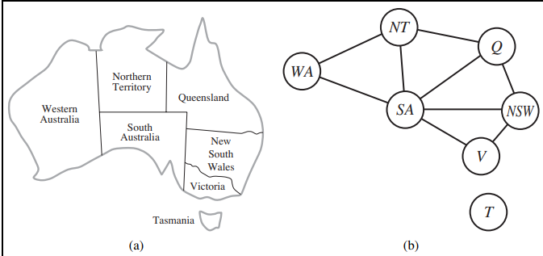
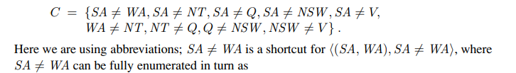
Example problem: Map coloring
The problem is to colour the reasons of a given map such that no two adjacent regions have the same colours.
The reasons in the map are the variables and the set of possible colours for region. Is the domain.
Representation of problem
X = {WA, NT, Q, NSW ,V, SA, T}
The domain of each variable is the set Di = {red, green, blue}
Constraints adjacent regions must have different colours
{(red, green),(red, blue),(green, red),(green, blue),(blue, red),(blue, green)} . There are many possible solutions to this problem, such as {WA = red, NT = green, Q = red, NSW = green, V = red, SA = blue, T = red }.
It can be helpful to visualize a CSP as a constraint graph
Solutions are complete and consistent assignments

Slide 54
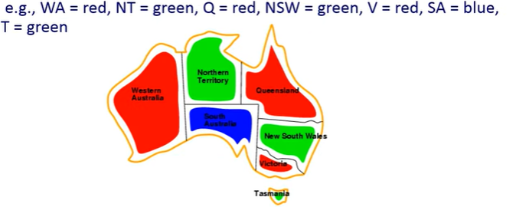
Most of the time, these problems has many solution The topology of constant graph can be used to identify solutions easily Mapcrating can be sometimes represented as graph colouring problem

Slide 55
Searching for goal state in CSP
Every solution must be a complete assignment, and therefore appears in depth. ‘n’if there are N variables
the search tree extends only to depth ‘n’
Depth first search algorithms are popular for CSP
The path by which a solution to be reached is irrelevant
Locals search methods work well for this formulation

Slide 56
1)Solve the cryptarithmetic puzzle: ts a unique digit, and no two letters can share the same digit.
SEND + MORE = MONEY
2)Solve the cryptarithmetic puzzle: ts a unique digit, and no two letters can share the same digit.
BASE+ BALL = GAMES
3)Consider the cryptarithmetic puzzle:
ABCD
+ EFGH
------
IJKL
------
4) CROSS
+ ROADS
-------
DANGER
discussed in class—please refer to the class notes for details.

Slide 57
Basic Steps to Solve Cryptarithmetic Puzzles:
Identify Unique Letters: First, list all unique letters in the puzzle.
Analyze the Arithmetic: Consider how the letters contribute to the arithmetic operations. For example, in addition puzzles, look for carries between columns.
Assign Digits Systematically: Start assigning digits to letters based on constraints (like leading digits cannot be zero) and logical deduction from the arithmetic structure.
Check for Consistency: Ensure that no two letters are assigned the same digit and that all operations are correct.

Slide 58
Tricks for Solving Cryptarithmetic Puzzles:
Look for the Highest Digit: Often, the letter that represents the highest digit can be deduced by looking at the structure of the addition. For example, in the addition puzzle where SEND + MORE = MONEY, M must be 1 because it results from a carry from the thousands place.
Analyze the Carry: Consider how carries affect the digits. This is crucial in multi-column arithmetic puzzles.
Use Constraints to Narrow Down Possibilities: For example, if you know a letter must be an odd digit or cannot be zero, use that to reduce possibilities.
Iterative Testing: Start with one plausible solution and test it through all conditions. If it fails, backtrack and try another.
CSP (Constraint Satisfaction Problems) Approach:
Define Variables: Each unique letter is a variable.
Define Domains: The domain for each variable is usually digits 0-9, except for leading digits which cannot be 0.
Define Constraints: Constraints are arithmetic rules that the solution must satisfy. For example, the sum or multiplication across columns must be correct considering carries
Use Backtracking: This is a common method to solve CSPs. Start assigning values to variables and backtrack whenever a conflict arises.

